Slide 1
Predictive Analytics (Machine Learning)
Slide Set VII – Evaluation of ML Josh Bernhard University of Colorado - Denver

Slide 2
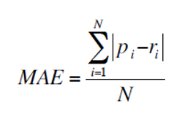
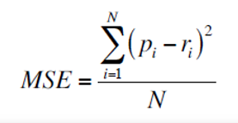

Evaluation Methods
Evaluating the fit of models when the response is quantitative is generally done by looking at either
Mean-Absolute Error (MAE)
Mean-Squared Error (MSE)
We choose a model that minimizes MAE or MSE in the validation data when the model is created from the

Slide 3
Evaluation Methods
Evaluating the fit of models where the response is done by looking at the proportion of correct/incorrect classifications.
Many times this is done in a confusion matrix, as some miss-classifications can be more detrimental than others.
We also will usually provide an overall miss-classification rating:
(total wrong)/(total predictions)

Slide 4

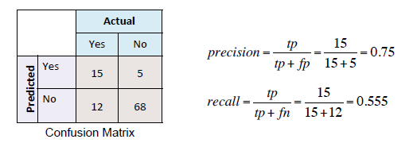
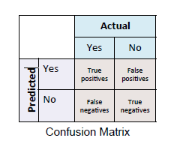
Evaluating Classification Models
Example
Confusion matrix for whether or not a customer purchases a product.

Slide 5
http://gim.unmc.edu/dxtests/roc3.htm
Discuss this?

Slide 6
Evaluation Methods
For any model, we would like to choose the model that provides the lowest MSE, MAE, or miss-classification.
For a comparison of different techniques, the following paper is a useful source: https://www.cs.cornell.edu/~caruana/ctp/ct.papers/caruana.icml06.pdf
It encompasses many of the techniques we discussed.

Slide 7
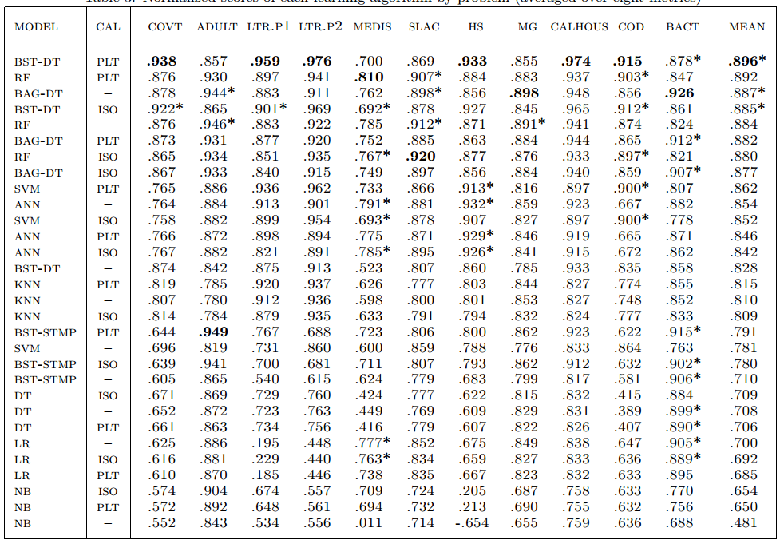
Evaluation Methods

Slide 8
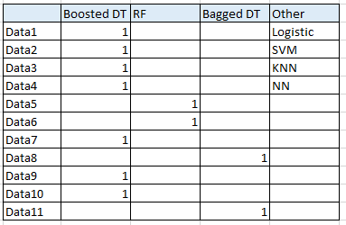
Evaluation Methods
Study shown in ML in Python by Michael Bowles.
Many methods evaluated
Top performing ML Methods.

